Slide 1
Cardiac Arrhythmia: irregular heartbeat
Arrhythmic classification
Atrial (aka supraventricular arrhythmia. Originates above bundle of His)
Atrial flutter: rapid coordinated atrial activity which does not originate in the SA node
Atrial fibrillation: rapid uncoordinated atrial activation which does not oroginate in SA
Junctional Arrhythmias
Supraventricular tachycardia (SVT)
AV nodal reentrant tachycardia
Ventricular
ventricular arrhythmia
Ventricular fibrillation
Heart block: causes bradycardia
1st degree heart block: PR prolongation
2nd degree heart block: blocked conduction between atria and ventricles
3rd degree heat block: complete hear block
 | Atrial Flutter | Atrial Fibrillation
Rate | 250-350 bpm | 400 – 600 bpm
Pulse | Regular pulse | Irregular pulse
Ventricular rate | Varies | Vent is always slower than atrial

Slide 2
Classification of A.Fib
A.Fib Category | Definition | Maintenance
Paroxysmal A.Fib | On and off | Once resolved, no therapy necessary
Persistent A.FIb | On > 7 days and off | Rate control + Anticoagulation + Maybe DCC if reoccurring
Permanent A.Fib | On > 1 year | Rate control + Anticoagulation (no use trying to DCC b/c unable to maintain sinus rhythm)
Lone A.fib: no HTN and < 60 y/o
Lone paroxysmal A.fib: On and off w/o comorbid conditions. No HTN and < 60 y/o
Lone Persistent A.fib: on > 7 days and off w/o comorbid conditions. Not HTN and < 60 y/o

Slide 3
A.Fib
General algorithm
If stable:
Rate control: Beta blocker or CCB or Digoxin
+
Anticoagulant: ASA or warfarin
(use UFH to bridge patient if they are on warfarin)
if pt still has problems
& persistent
Rate control: Beta blocker or CCB or Digoxin
+
Anticoagulant: warfarin
+
DCC
if pt still has problems
& paroxysmal
if pt still has problems
Rate control: Beta blocker or CCB or Digoxin
+
Anticoagulant: ASA or warfarin
+
DCC
+
Anti-Arrhythmic

Slide 4
Acute A.fib
Hemodynamically
unstable
Hemodynamically Stable
Rate control + Anticoagulation
DCC
CHADS-2 Score
CHF: +1
HTN: +1
Age > 75 +1
DM +1
Stroke +2
Rate Control
if HF or s/p MI
If Asthma
If Hypotension
Beta Blocker
Verapamil
or
Diltiazem
Digoxin
If ≤1 then
ASA 81 mg
If > 1 then
UFH 70 Units/kg IV push then
UFH 15 Units/kg IV infusion
Bridge to
Warfarin 5 mg
If rhythm is still not controlled,
Patient is in Persistent A.fib
Then
Prepare for DCC (next slide)
Notes:
Don’t have to know dosing

Slide 5
Rate Control Drug | Onset | IV dose | PO dose
Digoxin | 2 hr | 0.25mg q6h x 4, then 0.125-0.25mg daily | 0.25mg q6h x 4, then 0.125-0.25 daily
Diltiazem | IV: 2-7 min PO: 2-4 hr | 0.25 mg/kg slow IV push, then 5-15 mg/hr | 30-90mg QID
Verapamil | IV: 3-5 min PO: 1-2 hr | 0.075-0.15mg/kg x 1 | 120-360mg daily (divided doses)
Esmolol | IV: 5 min | 0.05-0.2mg/kg/min | N/A
Metoprolol | IV: 5 min PO: 4-6hr | 2.5-5mg q5min, up to 3 doses | 25-100mg BID
Propranolol | IV: 5 min PO: 60 min | 0.15 mg/kg x 1 | 80-240mg daily (divided doses)

Slide 6
How to prepare for DCC to treat PERSISTENT A.fib:
(UFH) + 3 weeks warfarin → DDC → 4 weeks warfarin
If A.Fib < 48 hr
If A.Fib > 48 hrs &
If already been taken warfarin
If A.fib > 48 hrs &
If new to warfarin
Bridge Therapy
UFH 70 Units/kg IV push
UFH 15 Units/kg IV infusion
+
Warfarin 5 mg
When INR: 2-3
D/C UFH
Continue Warfarin
Wait at least 3 weeks until
warfarin is therapeutic
Wait at least 3 weeks until
warfarin is therapeutic
DCC + Ibutilide (III)
DCC + Ibutilide (III)
DCC + Ibutilide (III)
After DCC
Warfarin for 4 weeks
After DCC
Warfarin for 4 weeks
Notes:
Following cardioversion it can take up to 4 weeks for mechanical contraction of the atrium to return to normal, “atrial stunning”

Slide 7
If DCC fails, start anti-arrhythmic
Or
If patient is paroxysmal

Slide 8
Type | Drug | Use | Pros | Cons
IA Na channel | Quinidine Procainamide Disopyramide |  |  | Rarely used because of high risk of tDP
IC | Flecainide | No structural heart disease HTN w/o LVH | Can be used PRN | Must be on rate controller Rx such as BB, CCB
IC | Propafenone | No structural heart disease HTN w/o LVH | Can be use PRN | May cause Heart block and or Ventricular tachycardia
III | Amiodarone | HTN WITH LVH HF | Low pro-arrhythmic potential = safe in LFH and HF. Low tdP | Nausea, constipation, bradycardia, hypotension, hypothyroidism, blue/grey skin discoloration
III | Dronedarone | No structural Heart disease HTN w/o LVH CAD | Less thyroid problems then amiodarone | Less effective than Amiodarone
III | Dofetilide | CAD HF |  | Approved my physician
III | Sotalol | No structural Heart disease HTN w/o LVH CAD | Class III + beta blocker | Renally Cleared. Torsades if pt has bad kidneys
Notes:
CAST trial for IC drugs: increase mortality + nonfatal cardiac arrest so should only be used in life threatening arrhythmias

Slide 9
A.Fib antiarrhythmics
A.Fib +
No Structural
Heart Disease
A.Fib +
HTN
w/o LVH
A.Fib +
HTN
WITH LVH
CAD
HF
First Line
Class IC: Flecainide & Propafenone
Class III: Sotalol & Dronedarone
First Line
Amiodarone
First Line
Class III: Sotalol & Dronedarone
& Dofetilide
First Line
Amiodarone
Dofetilide
Amiodarone IV
150 mg IV bolus then 150 mg
1 mg/min x6hours then 360 mg
0.5 mg/min x18 hours 540 mg
Total 1050 mg = 1 gram
or
Amiodarone PO
400 mg PO TID
Continue until 5-10 grams total then
200 – 400 mg PO daily
Second Line
Amiodarone b/c S/E
Dofetilide b/c physician approval
Notes:
Antiarrhythmic drugs will cause an negative inotropic effect, except for
Amiodarone and dofetilide (class III) are safe
IC not used for LV dysfunction or s/p MI b/c of increased risk of proarrhythmia

Slide 10
 | Flecainide IC | Propafenone IC | Sotalol III | Dronedarone III | Amiodarone III | Dofetilide III
No structural disease | + | + | + | +
HTN w/o LVH | + | + | + | +
HTN with LVH |  |  |  |  | +
CAD |  |  | + | + |  | +
HF |  |  |  |  | + | +
No structural disease & HTN without LVH
-Class IC drugs b/c IC (Na blockers) are only indicated for pts with structurally normal hearts
-Sotalol is K blocker and BB so BB can help with HTN?
- Dronedarone should NOT be given with LVH nor HF (everyone else is ok?)
HTN with LVH
- Amiodarone: Most effective antiarrhythmic to decrease A.Fib burden. low proarrhythmic potential
CAD
- Sotalol b/c beta blocking?
- Dronedarone should NOT be given with LVH nor HF (everyone else is ok?)
HF
- Amiodarone: b/c HF is the most serious. Needs the most serious drug? (not Dronedarone b/c death)
- Dofetilide: b/c HF is the most serious. Needs the most serious drug?
Notes:
? = making stuff up b/c her slides don’t have enough info
dronedarone should not be administered to patients with depressed ventricular function and recent heart failure decompensation or NYHA class IV heart failure.
The toxicity of amiodarone relegated it to second-line therapy, except for patients with substantial left ventricular hypertrophy or heart failure.

Slide 11
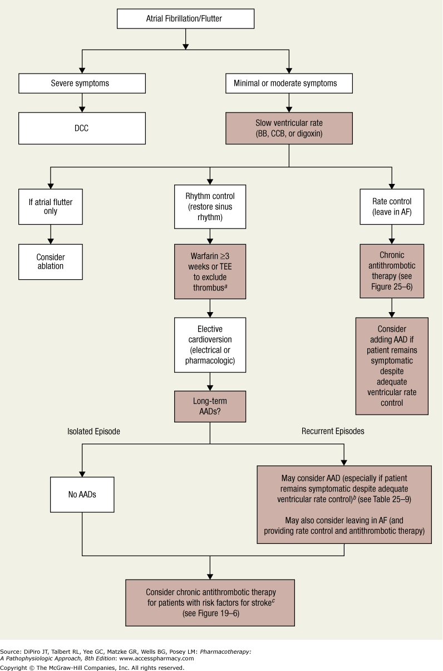

Slide 12
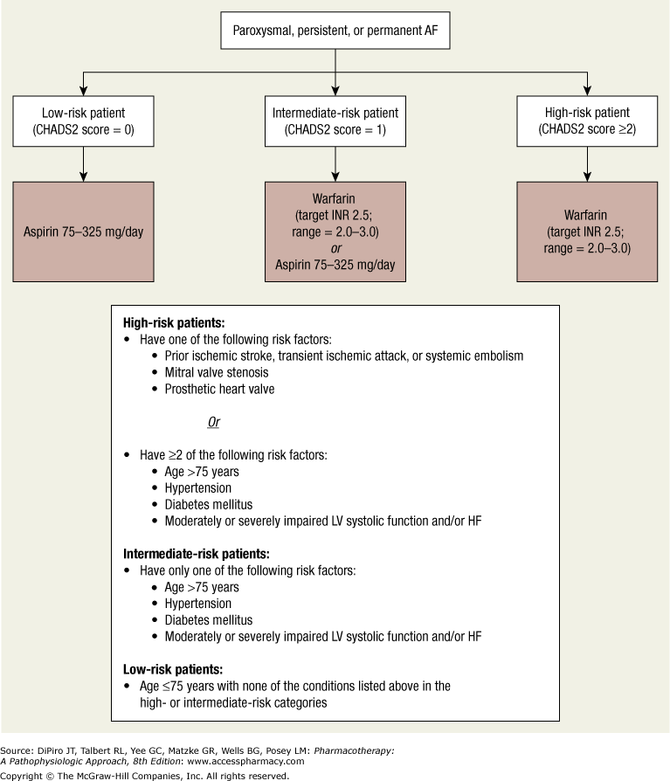

Slide 13
Class II Beta blockers:
MOA: works on SA and AV node only by blocking Ca influx
(BB and CCB work on both)
Effect
Negative CHRONOtrope : depress SA node
Negative DROMOtrope : depress AV
Negative Inotrope : depress muscle contractility
SA first
C before D
AV second
Class IV: Non-Dihydropyridine CCB
MOA: works on SA and AV node only by blocking Ca influx
(BB and CCB work on both)
Effect
Negative CHRONOtrope : depress SA node
Negative DROMOtrope : depress AV
Negative Inotrope : depress muscle contracility
Notes:
chrono-, meaning time, and tropos, "a turn”
"dromos", meaning running, a course, a race

